Slide 1
Implementation Science 101
The Impact Center at FPG
Frank Porter Graham Child Development Institute
University of North Carolina at Chapel Hill
PRESENTER NAMES
MONTH DATE, YEAR

Slide 2
Agenda
Check-in and Questions
Introduction to Implementation Science – Why do we need implementation science?
Overview of Our Integrated Theory of Change – What do we do in our work with you?
Overview of our support model – How do we do our work/what can you expect in working with us?

Slide 3
Check-in Questions
What do you know about implementation science?
What do you want to know about implementation science?

Slide 4
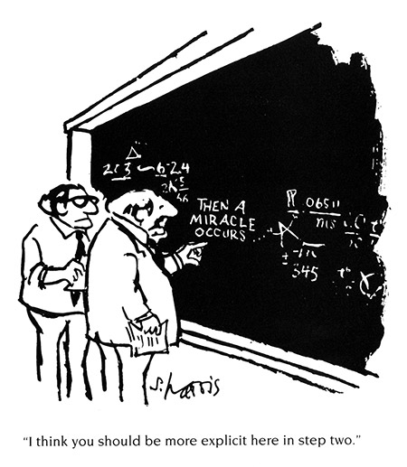
Implementation Site
Program Purveyor
Funder
Child & Family
Outcomes
Notes:
We think about this stage and refer to it as the black box we need to unpack more in order to effectively put programs in place to get to the outcomes shown in research.

Slide 5
Prior to your current work, what programs or practices did you have a hand in trying to implement or scale?

Slide 6
Implementation Science
Business unusual

Slide 7
What do we mean by “implementation?”
“…requires to be measured with outcomes that are conceptually and empirically distinct from those to assess intervention effectiveness.”
(Pérez et al.; 2016)
Learning Objective #1
Notes:
Equation adapted from Fixsen, D., Blase, K., Metz, A., & Van Dyke, M. (2013) Statewide implementation of evidence-based programs. Exceptional Children, 79, 213-230.
Pérez, D., Van der Stuyft, P., Zabala, M. C., Castro, M., & Lefèvre, P. (2016). A modified theoretical framework to assess implementation fidelity of adaptive public health interventions. Implementation Science : IS, 11, 91. doi:10.1186/s13012-016-0457-8

Slide 8
Leadership & Implementation Teams
Workforce Development
Systems
Quality & Outcome
Monitoring Systems
Media & Networking
Systems
Local Implementation & Scale Up – System Capacity & Performance
Leading & supporting
implementation
Developing competent
& confident practitioners
Gathering, analyzing,
& reporting data
System-wide learning
& improvement
Mobilizing knowledge
& behavior change
(Aldridge, Boothroyd, Fleming, Lofts-Jarboe, Morrow, Ritchie, & Sebian, 2016)
Learning Objective #2
Notes:
When capacity is built and performing in these key areas, the performance goals/outcomes are in green above. The CCA is focused on measuring capacity in a snapshot of the moment in time that we are administering and then looking for growth and areas of need over time in order to plan for our support and what you all need in your initiative. There is also an implementation drivers assessment IDA for use with service delivery agencies.
Aldridge, W. A., II, Boothroyd, R. I., Fleming, W. O., Lofts Jarboe, K., Morrow, J., Ritchie, G. F., & Sebian, J. (2016). Transforming community prevention systems for sustained impact: Embedding active implementation and scaling functions. Translational Behavioral Medicine, 6, 135-144. doi:10.1007/s13142-015-0351-y
Aldridge, W.A., II, Brown, J., & Bumbarger, B. K. The role of external change agents in developing hospitable service systems for scaling effective prevention strategies. Manuscript in preparation.

Slide 9
Feedback
Co-Creation
Partner Support
Local Implementation & Scale-up
Optimization of Implementation & Scale-up Outcomes
Desired Population-level
Outcomes
System Capacity
System Performance
Community members & partners
Service agency leadership & staff
State/local funders & policymakers
Intervention purveyors & Intermediary partners
Intervention developers & researchers
Leadership & implementation teams
Workforce development systems
Quality & outcome monitoring systems
Media & networking systems
Leading & supporting implementation
Developing confident & competent practitioners
Gathering, analyzing, & reporting data
System-wide learning & improvement
Mobilizing knowledge & behavior change
Adoption
Feasibility
Appropriateness
Fidelity
Adherence
Quality
Caregiver engagement
Dosage
Acceptability
Reach
Cost
Sustainability
Increases in indicators related to advantageous child & youth experiences, development
Decreases in indicators related to adverse child & youth experiences, development
Sustainment
Notes:
Aldridge, W. A., II, Boothroyd, R. I., Veazey, C. A., Powell, B. J., Murray, D. W., & Prinz, R. J. (2018, May). Ensuring Active Implementation Support for North Carolina Counties Scaling the Triple P System of Interventions. Chapel Hill, NC: The Impact Center at Frank Porter Graham Child Development Institute, University of North Carolina at Chapel Hill.
Chinman M, Acosta J, Ebener P, Malone PS, Slaughter ME. Can implementation support help community-based settings better deliver evidence-based sexual health promotion programs? A randomized trial of Getting To Outcomes®. Implementation Science. 2016;11(1):78.
National Academies of Sciences, E., & Medicine. (2019). Fostering Healthy Mental, Emotional, and Behavioral Development in Children and Youth: A National Agenda. Washington, DC: The National Academies Press.

Slide 10
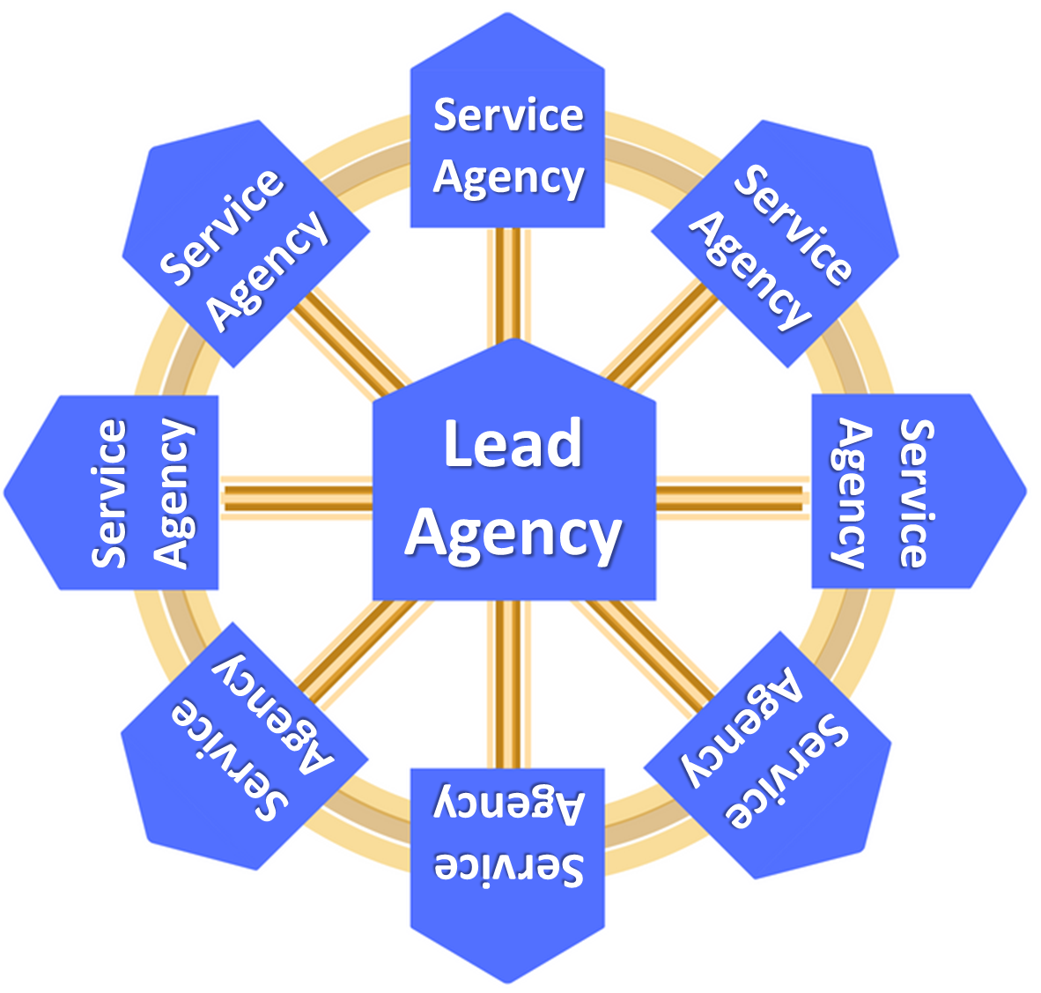
Partnership for Strategy and Governance (PSG)
NC Triple P State Learning Collaborative
Feedback
Support
Feedback
Triple P America
Support
Practitioners' Responsive & Effective Delivery of Triple P
The Impact Center at FPG
Feedback
NC Triple P Support System
PCANC
Parent and Family Wellbeing &
Self-Regulation
Support
Notes:
Here is what that co-creation partner support looks like in the NC system created to support the use of Triple P.

Slide 11
Foundational Practice Components (Constant)
Build collaborative relationships
Exploration (Exploration Stage)
Assess implementation capacity, implementation performance, and progress towards intended outcomes
Interactive Capacity Development (Installation Stage)
Provide adult learning on implementation science and best practices to leaders and teams
Supported Performance (Initial Implementation)
Facilitate leaders and teams’ application of skills, resources, and abilities within their context
Reinforce leaders and teams’ self-regulation of effective implementation performance
Transition out of intensive implementation support
Provide supportive behavioral coaching to leaders and teams
Facilitate collective learning and adaptive problem solving
Facilitate the development of implementation capacity
Facilitate collaborative agreements about implementation performance goals on which to focus support
What do we want to do?
Learn about it and build it.
Do it: practice, troubleshoot, get feedback.
Notes:
Really want to highlight that this is not a linear process. When we plan, provide, and track our support, we are using many of the core components all in a one-hour call.

